Slide 1
农作物病虫害识别
情绪诊疗辅助系统
违禁品检测
驾驶人/学生异常行为检测系统
其它
Notes:
Note:
This is a simple round rectangle that can represent some process, operation, or transformation
Author: Elvis Saravia (ellfae@gmail.com)

Slide 2
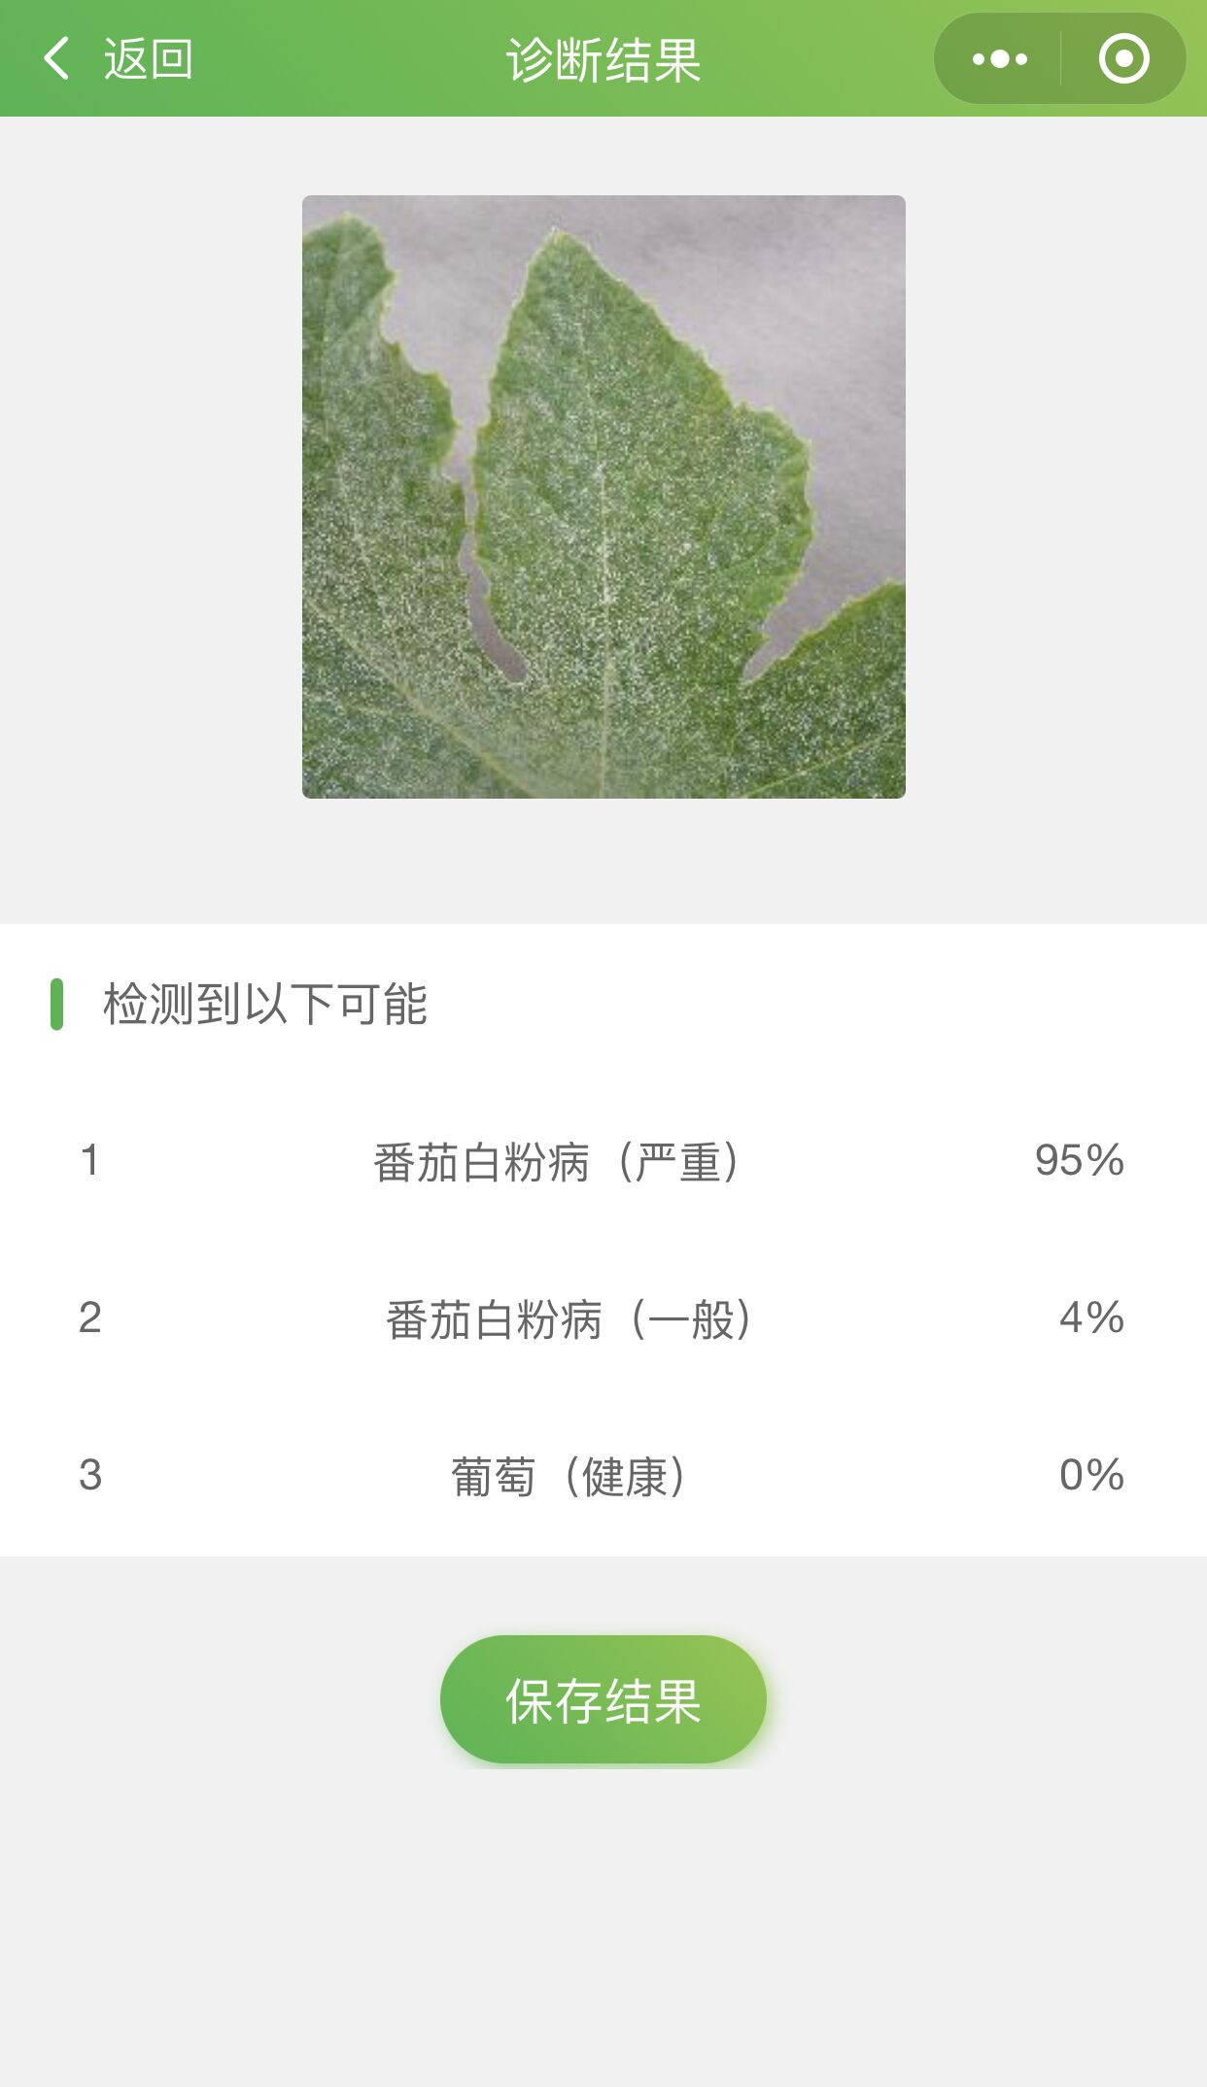
农作物病虫害识别
开放的比赛数据集：https://pan.baidu.com/s/1VH-KI-bpvF3oUj1KBNUJ5g 提取码：msrw
百度经典版【图像分类】训练模型
微信小程序调用接口识别
APP调用接口识别
参赛PPT、参赛报告
微信公众号

Slide 3
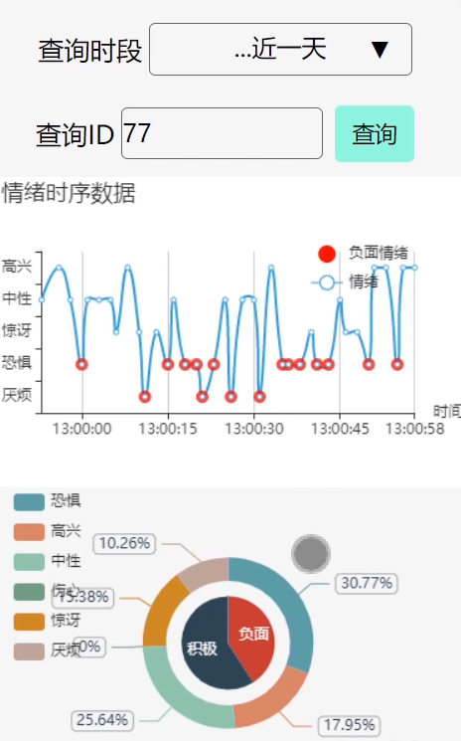
情绪诊疗辅助系统
数据：https://pan.baidu.com/s/1C2sKxVGMmPwpyTPkMvBMRg 提取码：36l9
系统
想想怎么实时监控人脸？--编造
做PPT、参赛报告
微信公众号

Slide 4
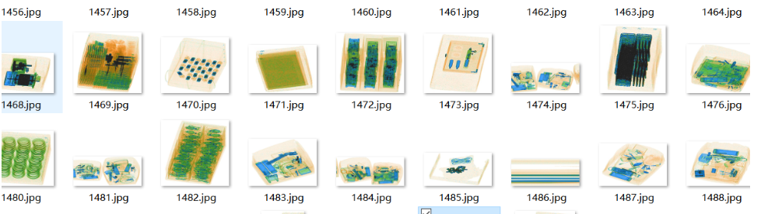
违禁品检测
百度专业版【物体检测】训练模型
实时违禁检测系统
参赛PPT、参赛报告
微信公众号

Slide 5
驾驶人/学生异常行为检测系统
异常行为：跌倒、抽烟、吃喝、烟雾、哈欠。。。
Yolov5系列

Slide 6
其它
4. 道路缺陷检测
5. 螺母质量检测
链接：https://pan.baidu.com/s/1FD3YNKBdlR8AGI41J92a7Q 提取码：huxk
6. PCB板缺陷检测
链接：https://pan.baidu.com/s/1Em19_jW_ZhHLaani9J6BiQ 提取码：jra0
7. X胸光片检测
链接：https://pan.baidu.com/s/1FmnQGZ6VFdmLblDV5ra_jA 提取码：xuge
8. 垃圾分类
9. 心音检测系统-----硬件：树莓派+。。。=
Notes:
Note:
This is the header I use for the dair.ai NLP Newsletter
You can change the gradient of each component
Author: Elvis Saravia

Slide 7
Notes:
Note:
This can be used to represent a vector. If you want to edit the distance between each element, you can “ungroup” the shapes and then modify the distance between the individual lines.
Author: Elvis Saravia (ellfae@gmail.com)

Slide 9
Level 1
Level 2
Level 3
Level 4
No Pain
Low Pain
Moderate Pain
High Pain
Signal Segmentation
Notes:
Note:
Can represent a multidimensional array (2D)
Author: Elvis Saravia (ellfae@gmail.com)

Slide 11
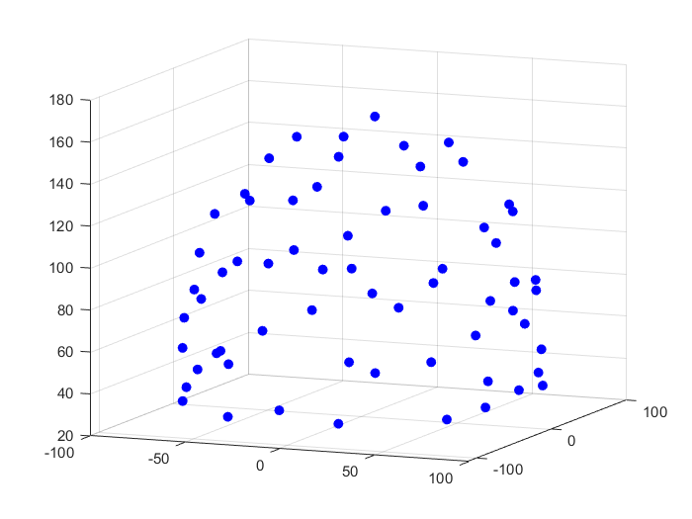
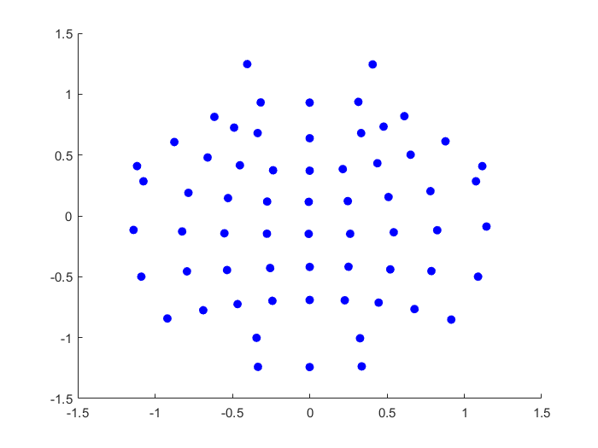
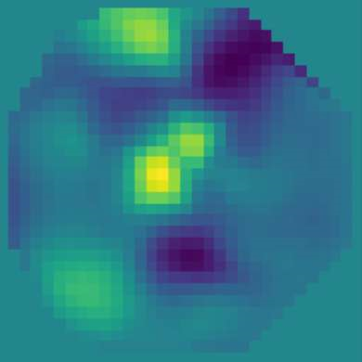
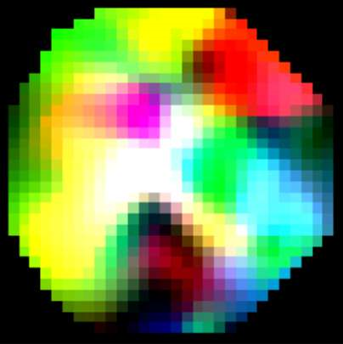
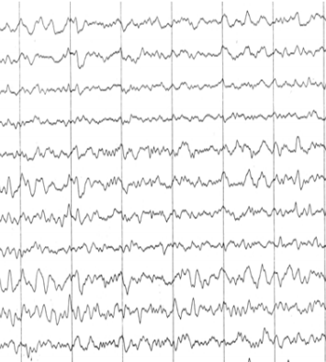
AEP
Bicubic
PSD
Theta(4~8Hz)
Alpha(8~13Hz)
Beta(13~30Hz)
Spectral Topography Map
FFT
Image Generation
Notes:
Note:
This can be used to represent a vector. If you want to edit the distance between each element, you can “ungroup” the shapes and then modify the distance between the individual lines.
Author: Elvis Saravia (ellfae@gmail.com)

Slide 12
Input
Conv3-32
x4
Maxpool
(2x2)
Conv3-64
x2
32x32x3
Maxpool
(2x2)
Conv3-
128
Maxpool
(2x2)
Output
FC-512
Feature
Vector
ConvNet Configuration
Notes:
Note:
These visuals can represent a multi-directional array (3D)
Author: Elvis Saravia (ellfae@gmail.com)

Slide 13
Layer1
Layer2
Layer3
Layer1
Layer2
Layer3
Layer4
Input
Output
Conv3-32
Conv3-32
Conv3-32
Conv3-32
Max-Pool
Conv3-64
Max-Pool
Conv3-128
Max-Pool
Conv3-64
FC-512
Input
Conv
Max-Pool
Conv
Max-Pool
FC
FC
Softmax
ConvNet Configuration
Stack1
Stack2
Stack3
Stack4
Conv3-32
Output
Feature
Vector
Conv3-32
Conv3-32
Conv3-32
Max-Pool
Conv3-64
Max-Pool
Conv3-128
Max-Pool
Conv3-64
FC-512
Notes:
By @avsthiago

Slide 14
Stack1
Stack2
Stack3
Stack4
Conv3-32
Output
Conv3-32
Conv3-32
Conv3-32
Max-Pool
Conv3-64
Max-Pool
Conv3-128
Max-Pool
Conv3-64
FC-512

Slide 15
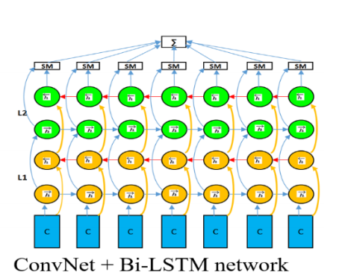
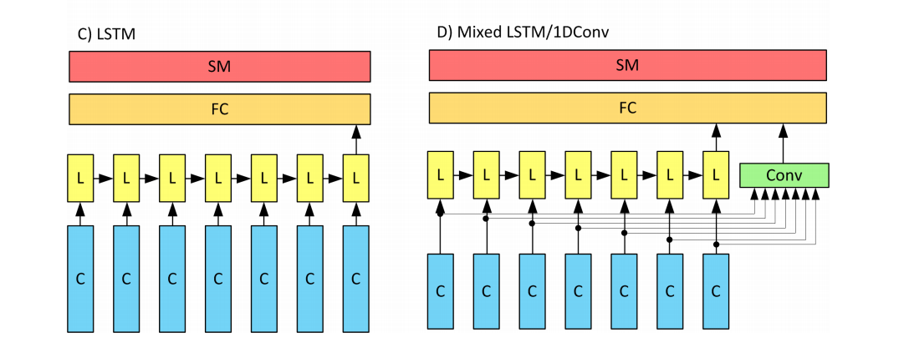
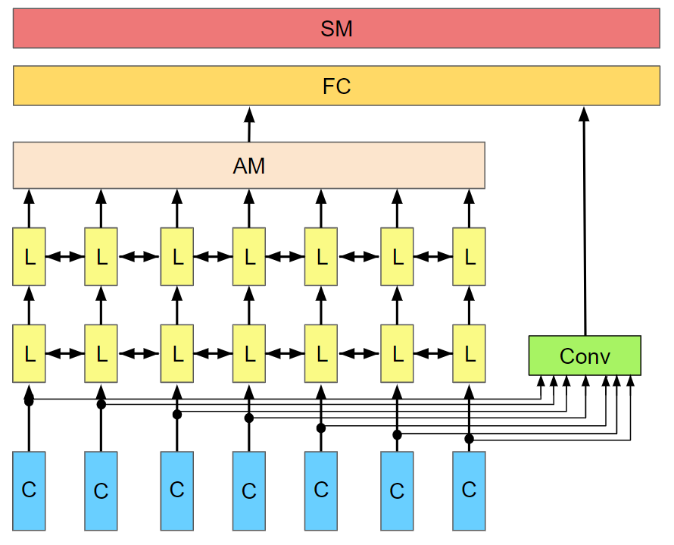
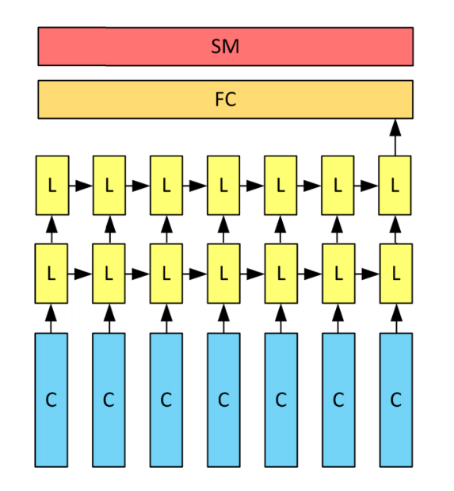
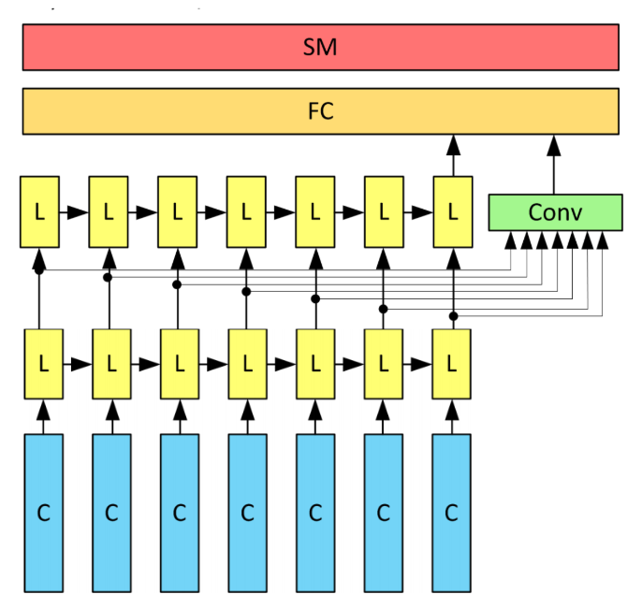
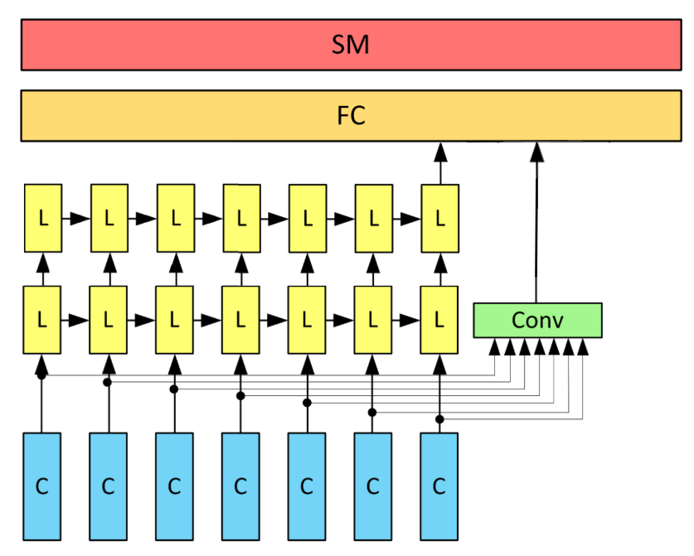
Notes:
Note:
Can represent a multidimensional array (2D)
Author: Elvis Saravia (ellfae@gmail.com)

Slide 16
SM
FC
AM
L
L
L
L
L
L
L
L
L
L
L
L
L
L
Conv
C
C
C
C
C
C
C

Slide 17
SM
FC
L
L
L
L
L
L
L
Conv
C
C
C
C
C
C
C

Slide 18
SM
FC
L
L
L
L
L
L
L
L
L
L
C
C
C
C
C
C
C
C
C
C

Slide 19
SM
FC
Conv
C
C
C
C
C
C
C
C
C
C

Slide 20
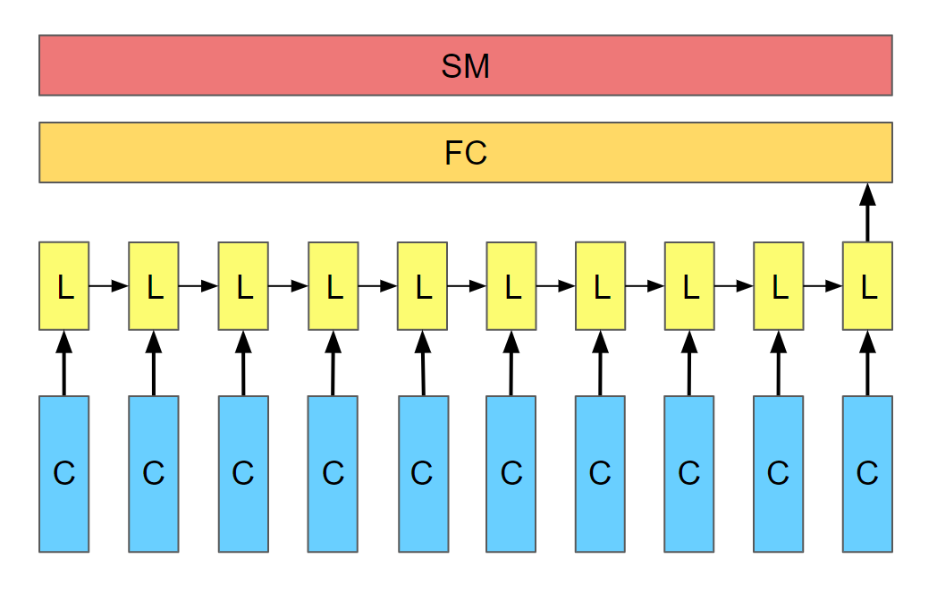
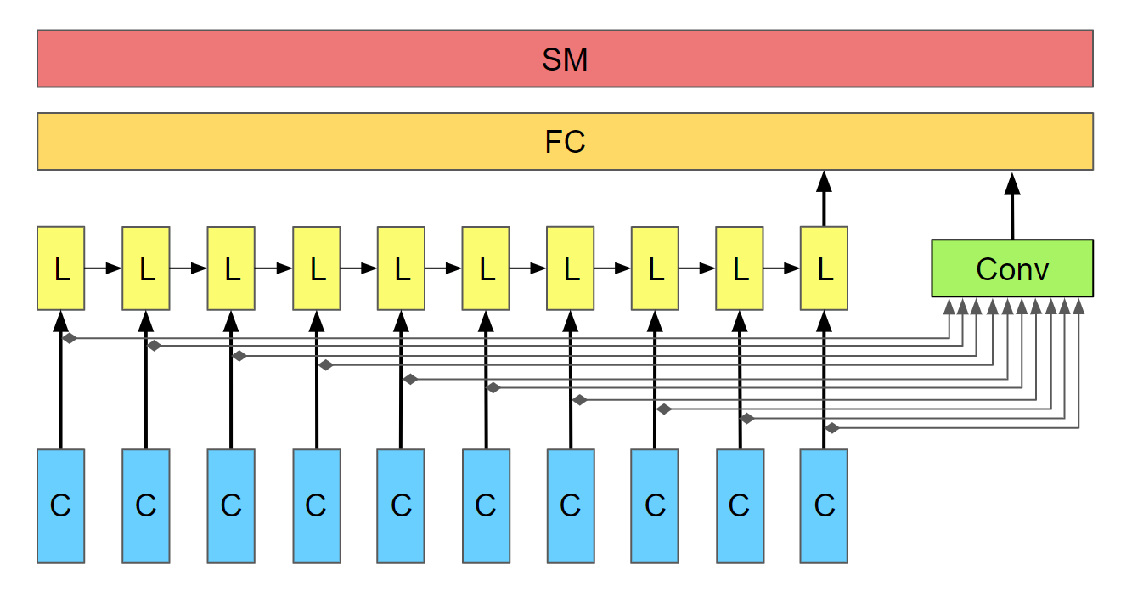
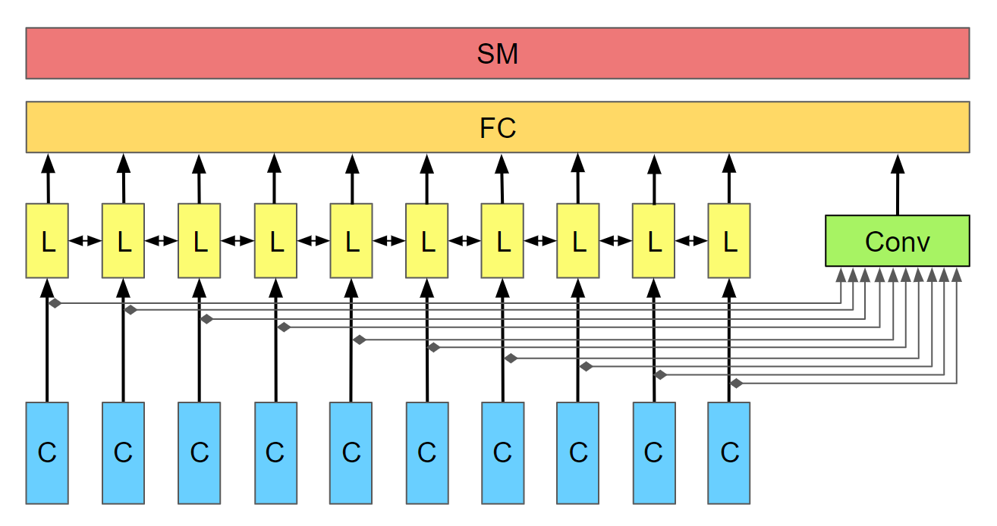
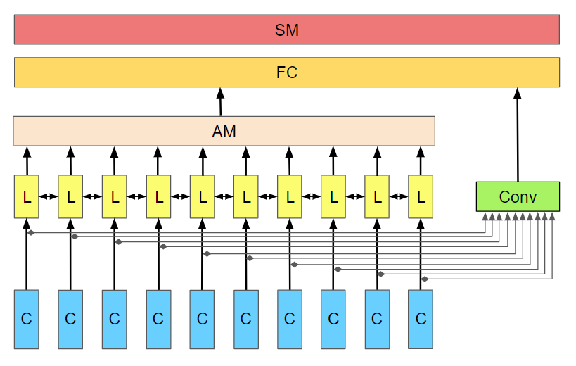
A) LSTM
B) Mixed LSTM / 1D Conv
C) Mixed BiLSTM / 1D Conv
D) Mixed Att-BiLSTM / 1D Conv

Slide 21
SM
FC
AM
L
L
L
L
L
L
L
L
L
L
Conv
C
C
C
C
C
C
C
C
C
C

Slide 22
SM
FC
L
L
L
L
L
L
L
L
L
L
Conv
C
C
C
C
C
C
C
C
C
C

Slide 23
SM
FC
AM
L
L
L
L
L
L
L
L
L
L
L
L
L
L
L
L
L
L
L
L
Conv
C
C
C
C
C
C
C
C
C
C

Slide 24
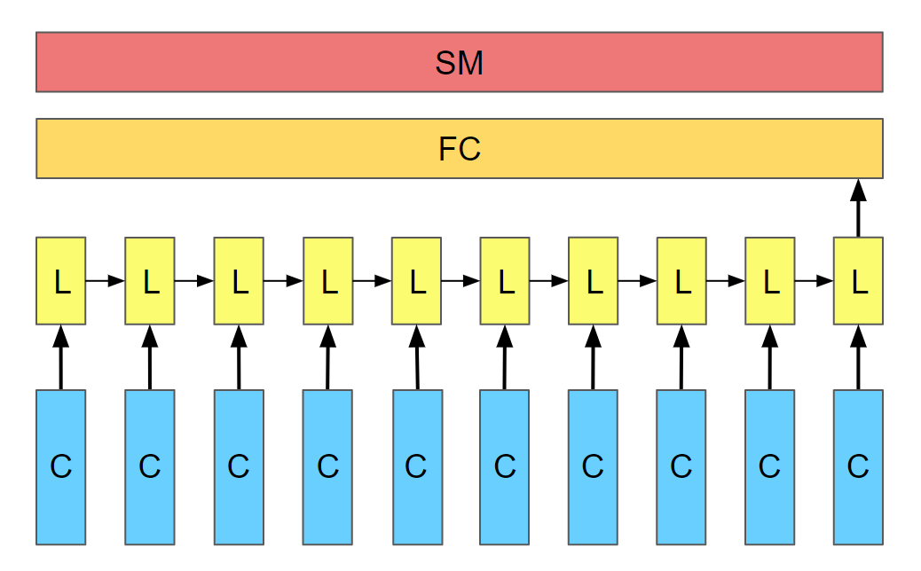
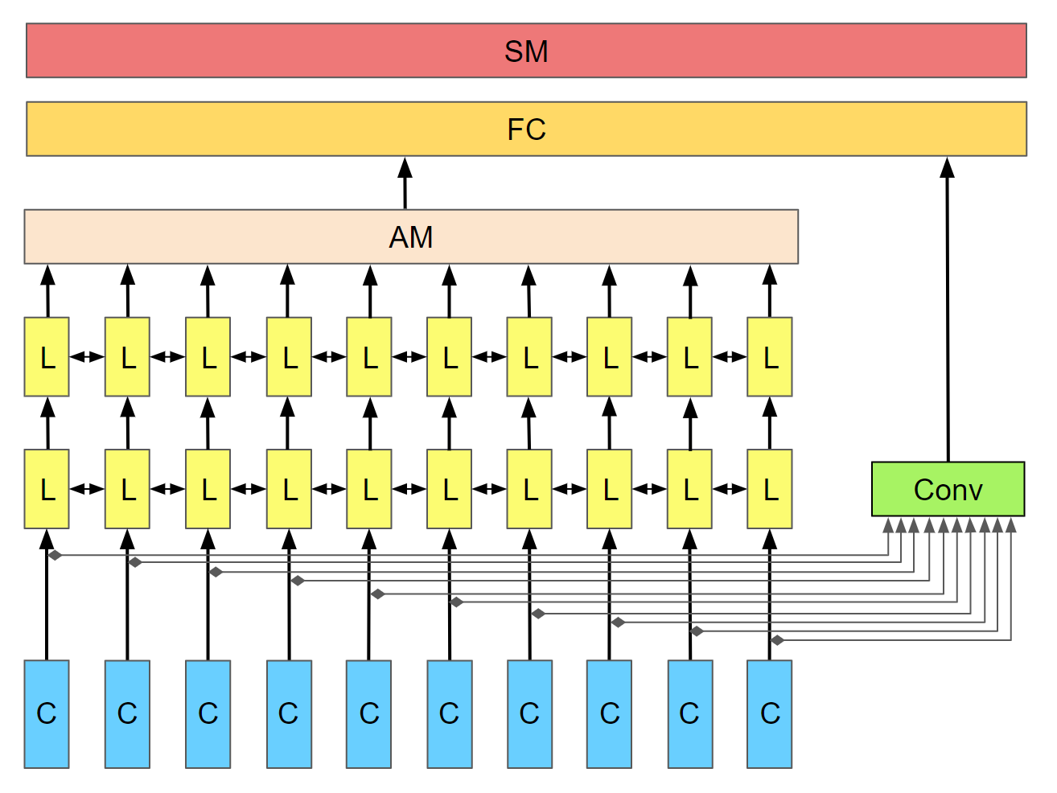

Slide 25
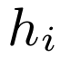
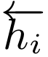
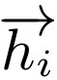
Attention layer
LSTM layer
CNN
layer
C
C
C
C
C
C
C
C
C
C

Slide 26
SM
FC
AM
L
L
L
L
L
L
L
Conv
C
C
C
C
C
C
C

Slide 27
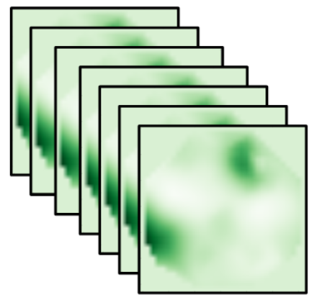
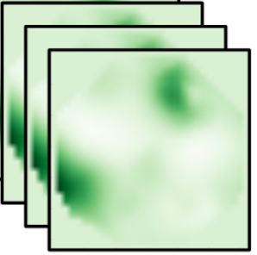
Conv
Conv
Conv
Conv
Conv
Conv
Conv
Conv
Conv
Conv

Slide 28
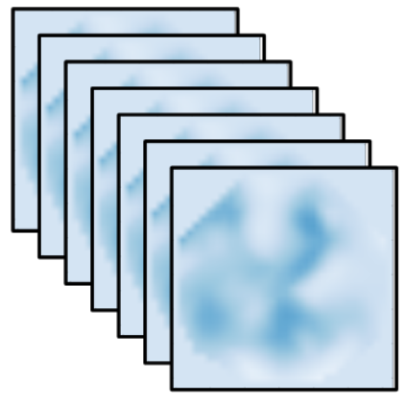


Slide 29
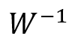
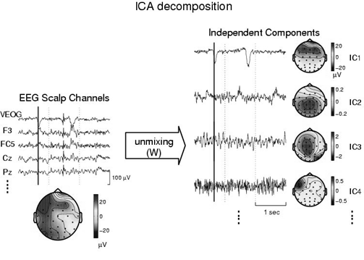
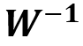
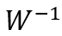
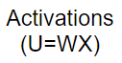
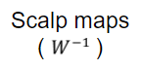
Activations
(U=WX)
Scalp maps
( )

Slide 30
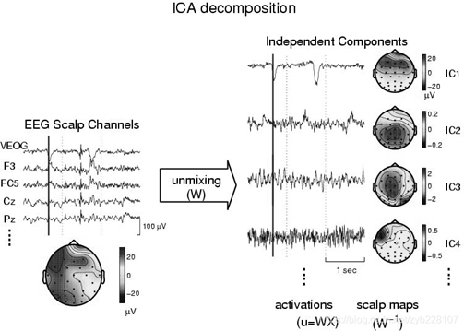
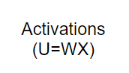
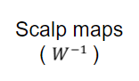

Slide 31
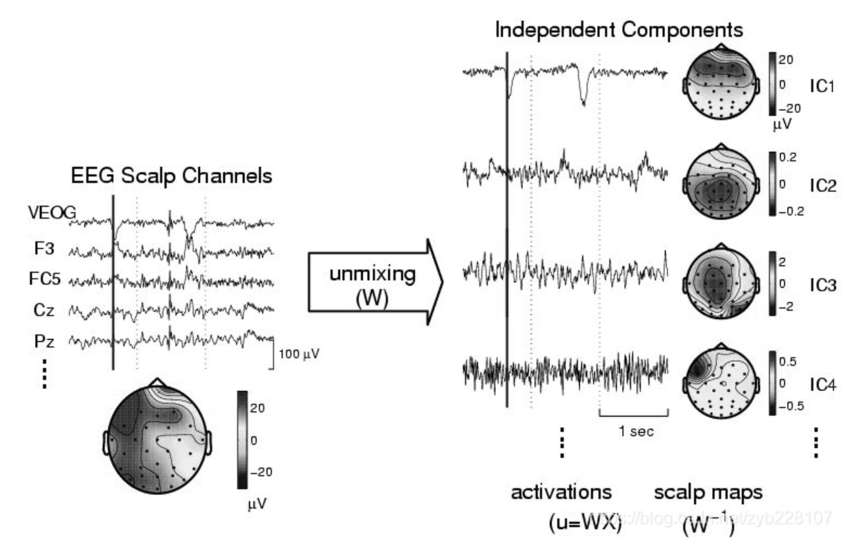
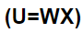

Slide 32
Test Subject | S1 | S2 | S3 | S4 | S5 | S6 | S7 | S8 | S9 | S10 | S11 | S12 | S13 | Average Accuracy
Pain Intensity | 0.8209 | 0.8882 | 0.9569 | 0.9625 | 0.9322 | 0.9563 | 1 | 0.9707 | 0.9809 | 0.9226 | 0.9015 | 0.892 | 0.8094 | 0.922623077
Pain Location | 0.7243 | 0.8028 | 0.9397 | 0.9951 | 0.9286 | 1 | 0.9948 | 0.9088 | 0.8844 | 0.8956 | 0.8816 | 0.7081 | 0.7591 | 0.878684615

Slide 33
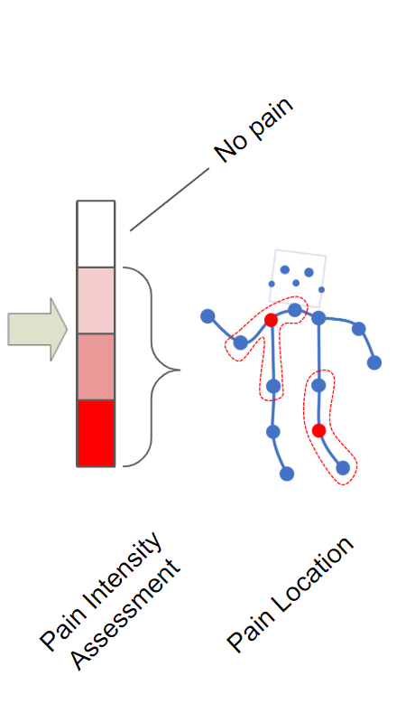

Slide 34
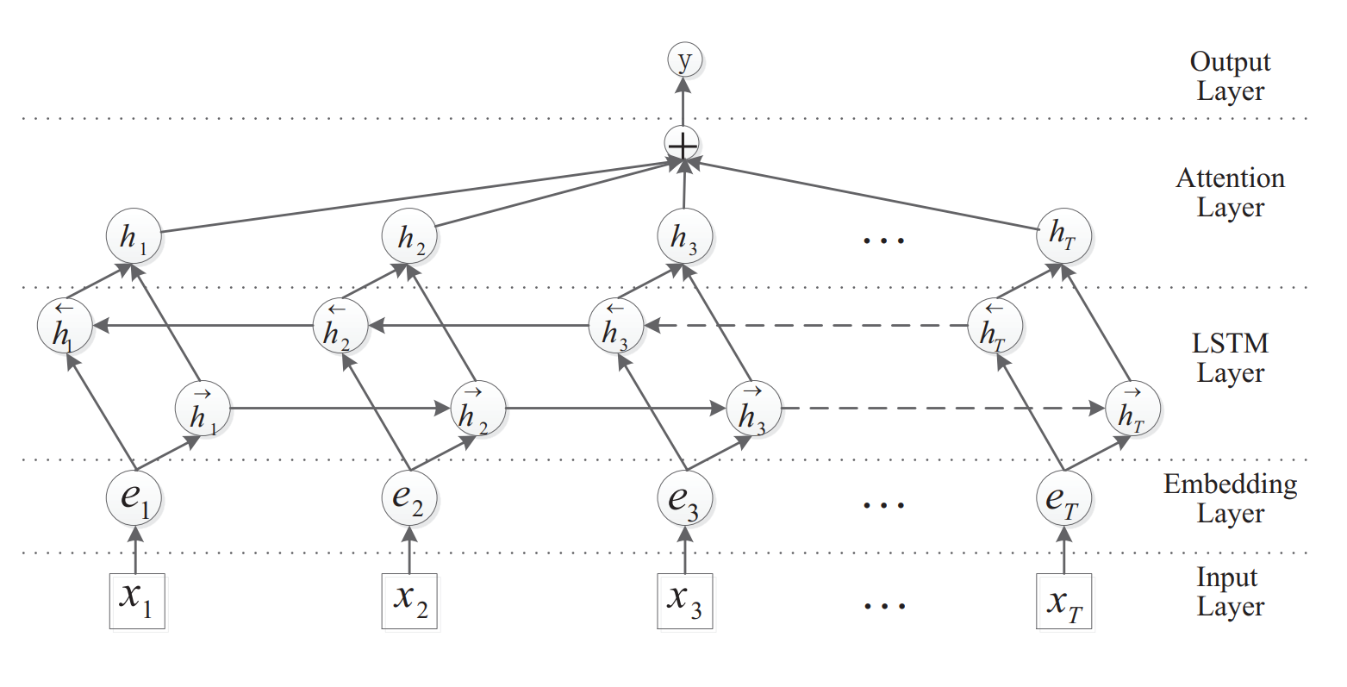
C
C
C
CNN
Layer

Slide 36
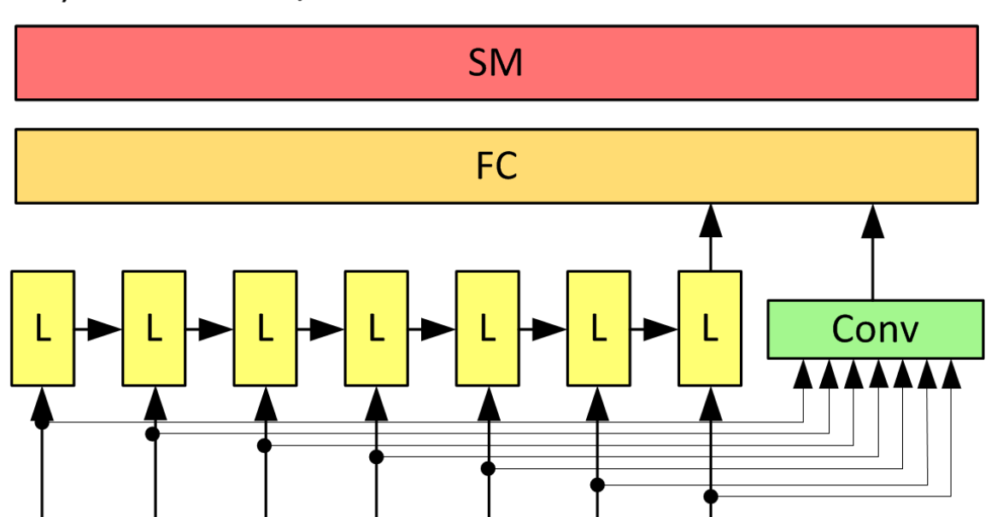
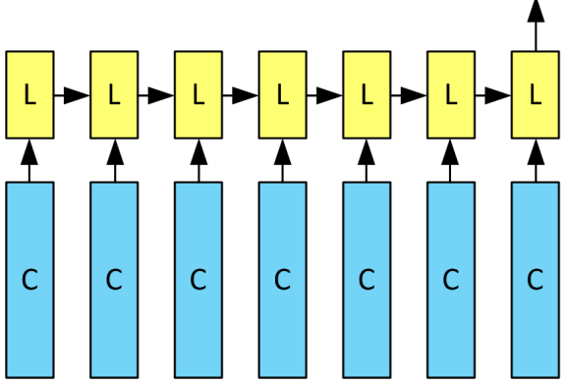

Slide 37
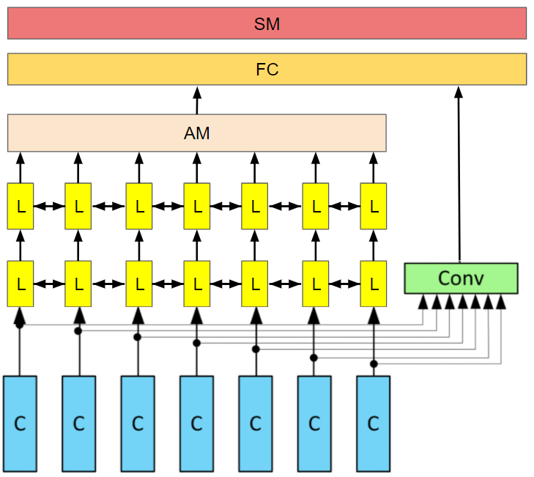

Slide 38
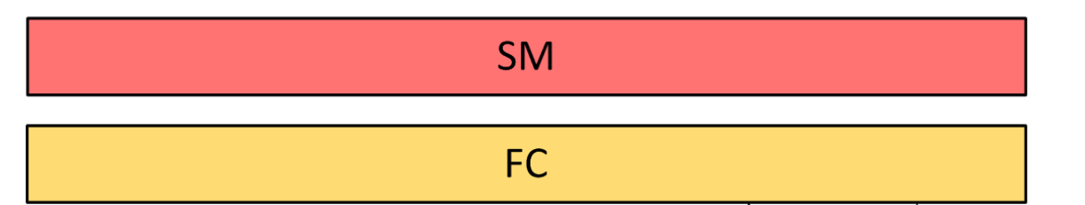
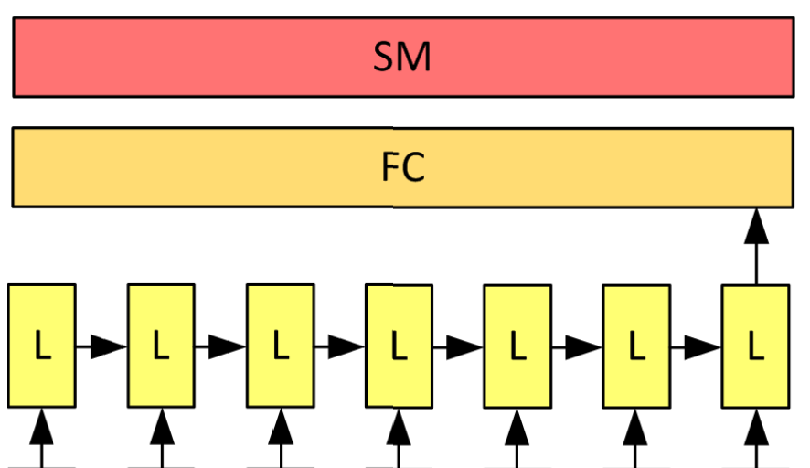

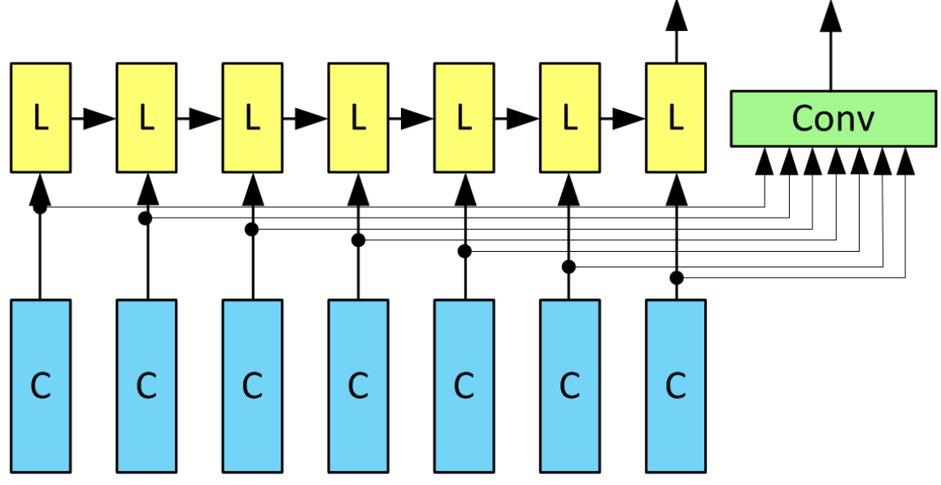

Slide 39
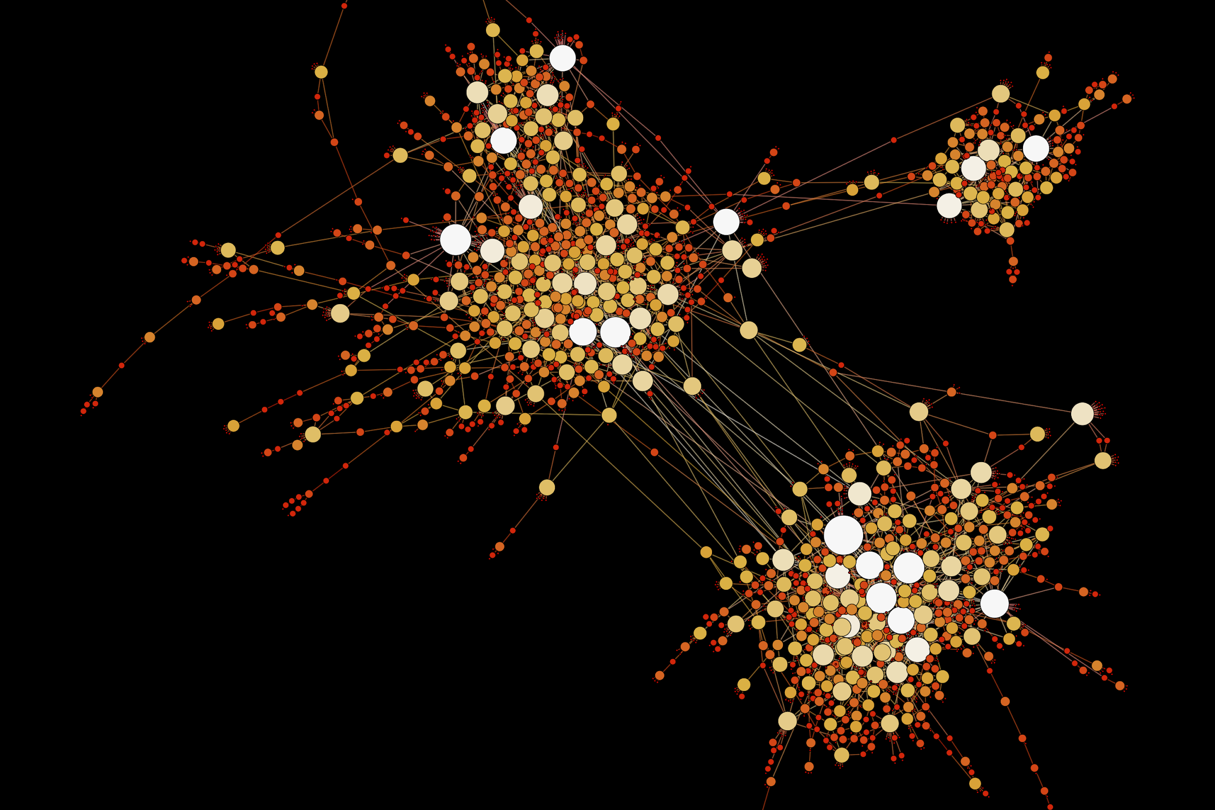
Notes:
Note:
This diagram could represent a simple logistic regression model; you can generalize to deep neural network by adding layers (see next slide)
Author: Elvis Saravia (ellfae@gmail.com)

Slide 40
Notes:
Note:
1 hidden layer neural network
Author: Elvis Saravia (ellfae@gmail.com)

Slide 41
ML Concepts
Notes:
Note:
Gradient background shows some inspirations and ideas for color themes that could be used for backgrounds
The examples used in this section are inspired by https://uigradients.com

Slide 42
256
225
56
.
.
.
214
210
211
NxN
NxN
NxN
NxN
R-G-B
Unrolling Feature vectors
Notes:
By @srvmshr
sourav@yahoo.com

Slide 43
Notes:
Note:
You can change the gradient of each component
Author: Elvis Saravia

Slide 44
Notes:
Note:
This is the header I use for the dair.ai NLP Newsletter
You can change the gradient of each component
Author: Elvis Saravia

Slide 45
Gradient Backgrounds
Notes:
Note:
Gradient background shows some inspirations and ideas for color themes that could be used for backgrounds
The examples used in this section are inspired by https://uigradients.com

Slide 46
Input:
(None, size, size, 3)
InputLayer
Output:
(None, size, size, 3)
Inception-v3 architecture
Input:
(None, 14, 14, 2048)
GlobalAveragePooling2D
Output:
(None, 2048)
Input:
(None, 2048)
Dense
Activation
ReLU
Output:
(None, 1024)
Input:
(None, 1024)
Dense
Activation
Softmax
Output:
(None, 7)
Notes:
By @avsthiago

Slide 47
Filter concatenation
3x3 convolutions
5x5 convolutions
1x1 convolutions
1x1 convolutions
1x1 convolutions
1x1 convolutions
3x3 max pooling
Previous layer
Notes:
By @avsthiago

Slide 48
Output
FC
FC
1x7 conv
1x7 conv
Inception 2
Inception 2
Inception 2
Inception 1
1x11 conv
1x11 conv
Input

Slide 50
Notes:
By @avsthiago

Slide 51
Notes:
By @avsthiago
Dark-theme version of the previous (by Elvis Saravia)

